Slide 1
Medical Terminology:
Learning Through Practice, 1e
Paula Bostwick
Chapter 13
The Lymphatic System
and Body Defense
©McGraw-Hill Education. All rights reserved. Authorized only for instructor use in the classroom. No reproduction or further distribution permitted without the prior written consent of McGraw-Hill Education.

Slide 2
Learning Outcomes
13.1 Identify the parts of the lymphatic and immune systems and discuss the function of each part.
13.2 Recognize the major word parts used in building words that relate to the lymphatic and immune systems.
13.3 Identify the common diagnostic tests, laboratory tests, and clinical procedures used in testing and treating disorders of the lymphatic and immune systems.
13.4 Define the major pathological conditions of the lymphatic and immune systems.
13.5 Explain the meaning of surgical terms related to the lymphatic and immune systems.
13.6 Recognize common pharmacological agents used in treating disorders of the lymphatic and immune systems.
13.7 Identify common abbreviations associated with the lymphatic and immune systems.

Slide 3
LO 13.1 Structure and Function
Lymphatic and immune systems share common structures and functions.
Immune system uses other systems to maintain function.
Both contain lymph nodes, spleen, thymus gland, and immune cells.
Lymphatic system is the site of collection for foreign substances.

Slide 4
Lymphatic System
Reduces edema
Returns proteins to blood
Traps / filters cellular debris
Recycles body fluids
Circulates lymphocytes
Moves fat from GI tract to blood

Slide 5
Immune System
Body defense against foreign bodies
Fights infections
Produces antibodies (immunoglobulins)

Slide 6
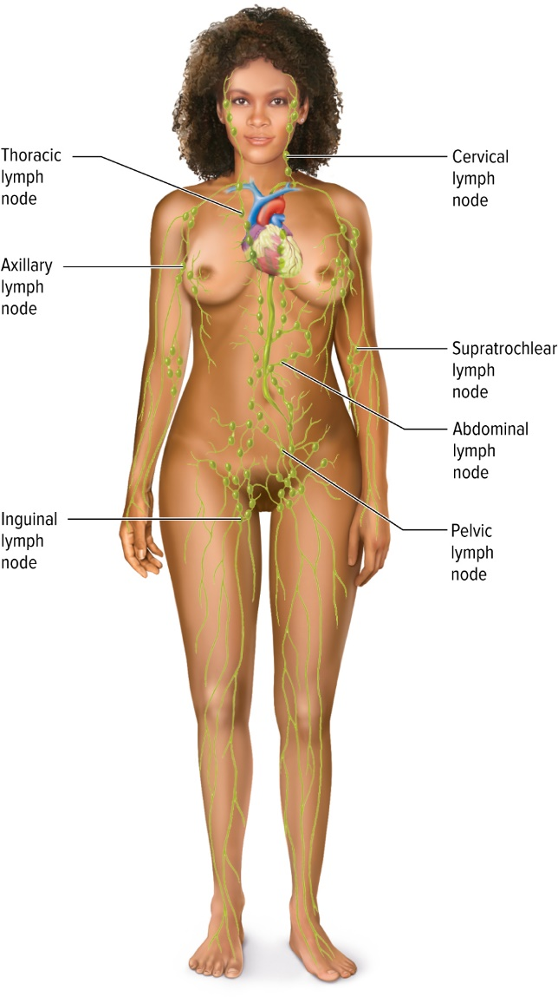
Location of Lymph Nodes
Access the text alternative for these images

Slide 7
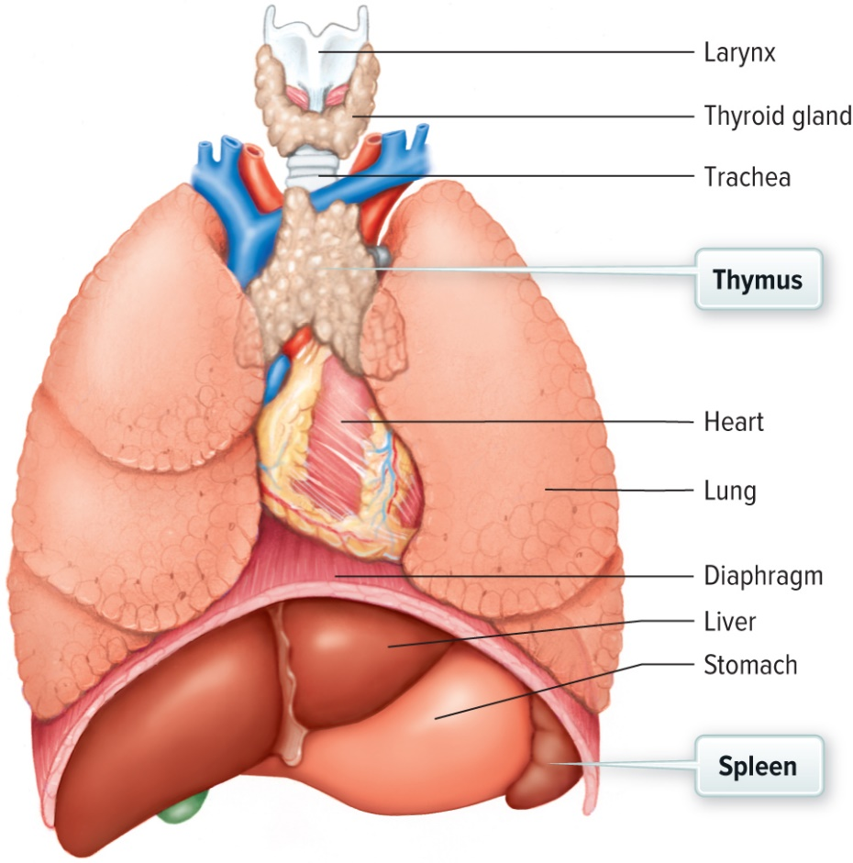
Spleen / Thymus
The spleen is located under the ribcage and above the stomach in the left upper quadrant of the abdomen. The thymus gland is located behind the sternum and between the lungs.

Slide 8
Lymphatic Organs
Involve network of vessels
Plasma can enter cellular areas of body
Interstitial fluid
Provide nutrients during fluid exchange
Drainage system to remove fluid
Concentrate foreign bodies

Slide 9
Lymphatic System
lymph
lymphatic pathways
lymphatic vessels
lymph node
spleen
thymus gland
T-cells (T lymphocytes)
B lymphocytes (B-cells)
thymosin

Slide 10
Lymphatic and Immune Vocabulary
aden(o) | gland
immun(o) | immunity
lymph(o) | lymph
lymphaden(o) | lymph nodes
lymphangi(o) | lymphatic vessels
splen(o) | spleen
thym(o) | thymus
tox(o), toxi, toxico | poison

Slide 11
The Immune System
Reticuloendothelial system
Hematopoietic system
Phagocytic system
Lymphoid system

Slide 12
Hematopoietic System
Production of blood cells
Erythrocytes (RBC)
Leukocytes (WBC)
Thrombocytes (platelets)

Slide 13
Phagocytic System
Immune / body’s defense
Lymph nodes, spleen, thymus gland
Protects the body
Skin’s and tonsils’ role in defense

Slide 14
LO 13.3 Diagnostic, Procedural, and Laboratory Terms
Assist in diagnosing medical conditions
Used in combinations
Lead to final diagnosis
Assist in treatment planning
  Lymphangiogram
  CAT Scan
  Allergy test

Slide 15
Diagnostics Review
enzyme-linked immunosorbent assay (ELISA)
enzyme immunoassay (EIA)
Western blot

Slide 16
LO 13.4 Pathological Terms
Diseases attack lymph tissue
Spread by lymphatic pathways
Flourish when immunity suppressed
Overreacting to invader
Attack the body itself
  HIV
  Allergy
  AIDS
  Retrovirus
  Opportunistic Infections

Slide 17
Opportunistic Malignancies and Infections with AIDS 1
Infection | Type | Area
candidiasis | caused by fungus, Candida albicans | GI, respiratory, skin, reproductive
cytomegalovirus | Herpesviridae | infects cells or organs, eyes, causes swelling

Slide 18
Opportunistic Malignancies and Infections with AIDS 2
Kaposi sarcoma | malignancy arising from capillary linings | skin and lymph nodes
MAI | caused by bacterium found in soil and water | systemic infection with fever, diarrhea, lung and blood disease, and wasting

Slide 19
Opportunistic Malignancies and Infections with AIDS 3
Pneumocystis jiroveci | caused by fungus, formerly known as Pneumocystis carinii | lungs—a particularly dangerous type of pneumonia

Slide 20
How HIV Is Transmitted
Sexual contact
Contaminated needles
During birth
Blood transfusion

Slide 21
How HIV Is Not Transmitted
Casual contact
Objects: toilet seats, deodorant, doorknobs, mosquitoes
Sneezing / coughing
Sharing food
Swimming with infected person

Slide 22
Allergic Response
Allergies are a disorder of the immune system that affect millions of people every year.

Slide 23
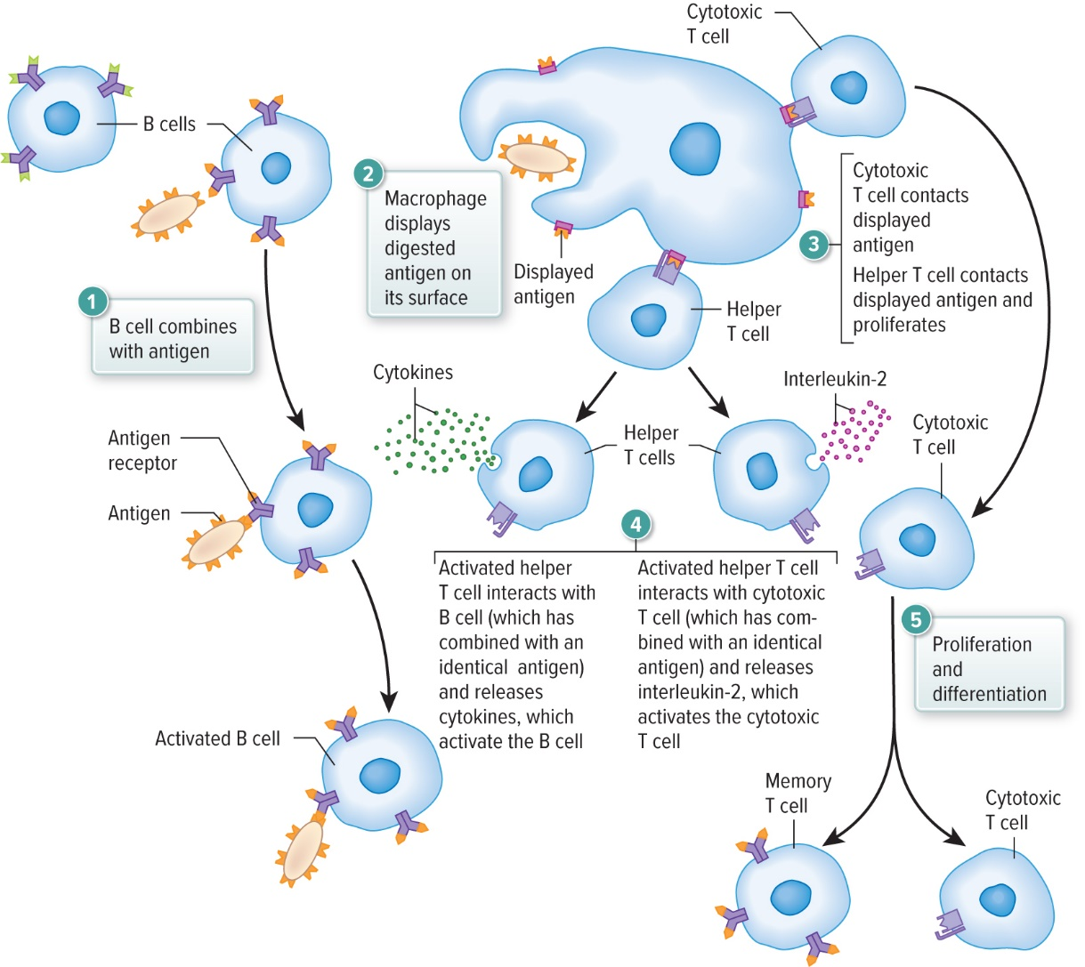
Immediate-Reaction Allergy

Slide 24
LO 13.6 Pharmacological Terms
Chemotherapy / Radiation
Managed for symptoms
AIDS / “cocktails”
Antiviral drugs = block growth
Antimicroorganism agent = pentamidine prevents PCP

Slide 25
LO 13.7 Abbreviations
AB (antibiotic)
EIA (enzyme immunoassay)
Ig (immunoglobulin)
PCP (Pneumocystis carinii pneumonia)
PMN (polymorphonucleated cells)
RES (reticuloendothelial system)

Slide 26
Chapter Summary 1
13.1 The lymphatic and immune systems share some of the same structures and functions. Both the lymphatic and immune systems contain the lymph nodes, spleen, thymus gland, and some of the disease-fighting immune cells. The lymphatic system provides the location to gather and concentrate foreign substances present in the body so that lymphocytes circulating through the lymphatic organs and vessels are able to destroy and remove them from the body. The immune system is the body’s defense system.
13.2 Word building requires knowledge of the combining form and meaning.

Slide 27
Chapter Summary 2
13.3 Diagnostic, procedural, and laboratory findings assist the health care provider in diagnosing medical conditions. Often used in combination, these tests lead to a final diagnosis and assist in treatment planning.
13.4 Diseases of the lymphatic and immune systems include diseases that attack lymph tissue itself, diseases that are spread through the lymphatic pathways, and diseases that flourish because of a suppression of the immune response. Disorders of the lymphatic and immune systems can be caused by an overly vigorous response to an immune system invader.

Slide 28
Chapter Summary 3
13.5 Surgery of the lymphatic system is usually related to a diagnosis of cancer. It is performed to determine the stage of the cancer so that the appropriate level of treatment may be initiated.
13.6 Diseases of the lymphatic and immune systems are often treated with relatively high doses of chemotherapy and/or radiation. Autoimmune diseases are often managed for symptoms, although some newer drugs have been able to slow the advance of such diseases.
13.7 Abbreviations are used to describe diseases, conditions, procedures, and treatments associated with the lymphatic and immune systems.

Slide 29
Accessibility Content: Text Alternatives for Images

Slide 30
Location of Lymph Nodes Text Alternative
Cervical lymph nodes are in the neck. Thoracic lymph nodes are in the chest. Axillary lymph nodes are in the armpits. Supratrochlear lymph nodes are in the elbow. Abdominal lymph nodes are in the abdomen. Pelvic lymph nodes are in the pelvis. Inguinal lymph nodes are in the groin.
Return to slide containing original image

